Slide 1
Eye Donation
# 1919
drishti.org.in | antardrishti.org
drishti@antardrishti.org

Slide 2
Introduction
We are one of the fastest growing economies in the world today; ironically, we also shoulder one of the largest populations of the visually impaired. There are almost 52 million visually impaired people and 270,000 blind children in India. That's almost one-fourth the world's blind population living in India. For the more academically oriented, as some economist pointed out, this could mean a cumulative loss of over $ 11.1 billion to our GNP! It is this kind of a grave situation that made the government initiate a first of its kind, dedicated program for the eradication of unnecessary blindness. However, even such programs are meager when compared to the magnitude of the problem.
# 1919
drishti.org.in | antardrishti.org
drishti@antardrishti.org

Slide 3
Problem Statement
According to Indian council of Medical Research (ICMR) study on blindness, about 25% of the total blind in India are blind due to corneal blindness. So, we require really a large number of people to donate their eyes if we want to treat these patients.
# 1919
drishti.org.in | antardrishti.org
drishti@antardrishti.org

Slide 4
How bad is the situation?
Open our eyes to this.
Out of the 9,500,000 deaths that occurred in the country last year, only a mere 10,000 had opted for eye donations. This is in contrast to the demand of about one million eyes per annum. Why this lack of concern? Well, some experts like to believe that such a callous attitude on part of society is due to a lack of a concerted effort on a national scale by everyone who needs to be involved, namely, professionals, the media, Government, voluntary organizations and civil society at large.
# 1919
drishti.org.in | antardrishti.org
drishti@antardrishti.org

Slide 5
What is Eye Donation?
Eye Donation is donation of our eyes after death so that our eyes can give light to a blind person’s life.
Eye donations are used for cornea transplants. The cornea is the clear outer covering of the eye. Through injury or disease it can become cloudy, causing blindness. But doctors can transplant a donated human cornea and restore sight.
The 2 eyes of a donated person will go to 2 different Corneal Blind individuals; so through our eyes, 2 blind people will get to see this world!
# 1919
drishti.org.in | antardrishti.org
drishti@antardrishti.org

Slide 6
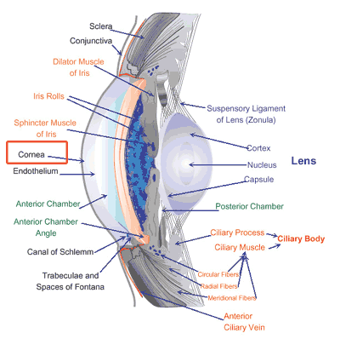
What is Cornea ?
This layer is the entry point for every eye to see things around you, in this world! If Cornea gets damaged, then well, it leads to blindness!
This is the outer layer at the front of the eye. The colored part of the eye (called Iris) and the round opening in it (called Pupil) can be seen through the cornea.
The Cornea helps to focus and transmit light as it passes to the lens and on to the Retina at the back of the eye. (When light reaches the retina, it is converted into impulses which are transmitted via the Optic nerve to the visual centre in the brain)‏
# 1919
drishti.org.in | antardrishti.org
drishti@antardrishti.org

Slide 7
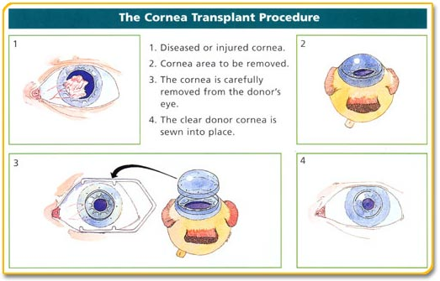
Corneal Transplants Procedure
# 1919
drishti.org.in | antardrishti.org
drishti@antardrishti.org

Slide 8
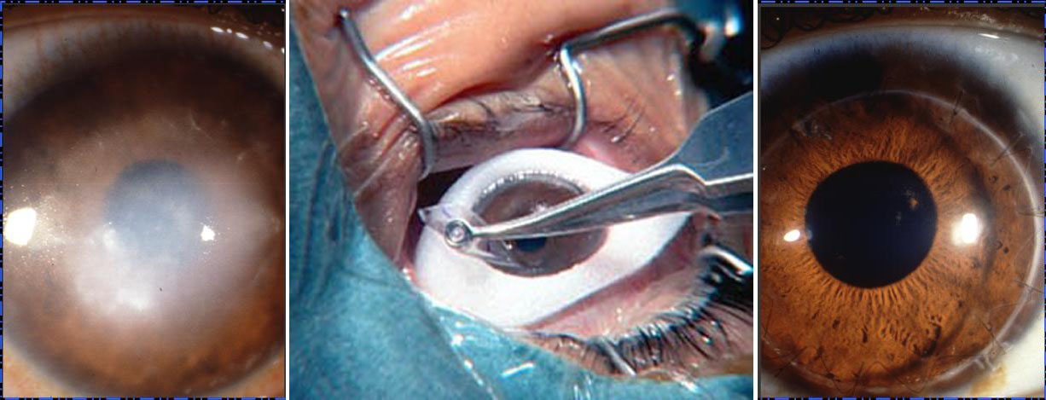
Corneal Transplants
Before
After
# 1919
drishti.org.in | antardrishti.org
drishti@antardrishti.org

Slide 9
Why should Eyes be donated?
There is no substitute for human tissue. The transplantation process depends upon the priceless gift of cornea donation (eye donation) from one human to the next. The use of artificial tissue for transplantation has been unsuccessful.
# 1919
drishti.org.in | antardrishti.org
drishti@antardrishti.org

Slide 10
Who can donate Eyes?
Anyone can donate eyes. It does not matter even if you
Have undergone any eye surgery
Poor Eyesight
Wear glasses
Diabetic
Hypertensive
Extremes of Age
# 1919
drishti.org.in | antardrishti.org
drishti@antardrishti.org

Slide 11
Facts about Eye Donation
Eyes can be donated only after death
Eyes must be removed within 4 - 6 hours after death
Only a Registered Medical Practitioner can remove eyes from a deceased.
The eye bank team will remove the eyes from the home of the deceased or from a hospital
Eye removal does not delay the funeral since the entire procedure takes 20-30 minutes only
A small quantity of blood will be drawn to rule out communicable diseases
Eye retrieval does not cause disfigurement
Religions are for eye donation
The identities of both the donor and the recipient are kept confidential
# 1919
drishti.org.in | antardrishti.org
drishti@antardrishti.org

Slide 12
Instruction for Eye Donation
To donate eyes, the relatives of the deceased should do the following procedures
Close the eyelids of the deceased
Switch off the fan
Raise the head of the deceased slightly by placing a pillow underneath
Contact the nearest eye bank as quickly as possible. CALL - 1919
Give the correct address with specific landmarks and telephone number to enable the eye bank team locate the place easily
If the death certificate from the physician is available, keep it ready
Eye donation can be done only with the written consent of the next of kin in the presence of two witnesses
# 1919
drishti.org.in | antardrishti.org
drishti@antardrishti.org

Slide 13
What can you do ?
Join hand with us for the movement of Eye Donation
Motivate family members of the person who has died in your area
Spread information about Eye Donation
This requires no money but only some precious time of yours –
leads to more Corneal Blind folks
to get their Sight and Enjoy the colors of this world, as we are doing!
Take the decision
# 1919
drishti.org.in | antardrishti.org
drishti@antardrishti.org

Slide 14
Donate your Eyes
You don’t need a degree, any special skills, or even perfect vision. All you need is a completed eye donor card, and a desire to help.
Talk to your family
Sign a donor card
Carry it with you
# 1919
drishti.org.in | antardrishti.org
drishti@antardrishti.org

Slide 15
To Donate Eyes Call 1919
If you have any queries, suggestions, feedback on Eye Pledging/Donation, please mail us @ eyedonation@antardrishti.org and we will try to clarify them at our best!
# 1919
drishti.org.in | antardrishti.org
drishti@antardrishti.org

Slide 16
At the end ...
Light up the darkness in life. Enable blind to see this beautiful world,
through your eyes!
Thank you
for your time!
# 1919
drishti.org.in | antardrishti.org
drishti@antardrishti.org

